Slide 1

Launching the Future: Strategy for Cutting-Edge AI Products

Slide 2

INTRODUCTION
A New Era of Technology: AI-Powered Solutions
AI Theft Camera
Advanced Surveillance for Theft Detection
Face Recognition System
Secure and Efficient Identity Verification
Home Automation (Hand Gesture)
Gesture-Based Control for Smart Homes
Customized Humanoid Robot
Innovative Robotics for Education and Retail

Slide 3
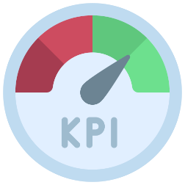
STEP-BY-STEP PROCESS
Market Analysis
Target Audience Analysis
Product Viability & Strategy
Scenario Analysis
KPIs

Slide 4

AI – Theft Camera

Slide 5
TO KNOW ABOUT THE PRODUCT
The AI Theft Camera is an advanced surveillance system designed to detect and prevent theft using AI-driven video analytics and real-time alerts.
It features real-time monitoring, smart home security integration, and a focus on data privacy and regulatory compliance.

Slide 6

COMPETITORS FOR THE PRODUCT
Competitors such as Veesion, Panoptyc, and Vaak offer similar solutions, with differentiators like gesture recognition and body language analysis.
NOTABLE ONE:
A Ring Security Cameras, which provide motion detection, real-time video streaming, and remote monitoring, showcasing the growing demand for such technologies in high-security areas

Slide 7

TARGET AUDIENCE
Financial institutions.
retail stores .
urban homeowners.

Slide 8
PSYCHOGRAPICS
Safety-Conscious: Concerned about theft and security risks.
Tech-Savvy: Open to integrating AI-powered tools for security.
Budget-Minded: Willing to invest in systems that prevent significant losses.
DEMOGRAPICS
Age: 30–60 years
Income Level: Middle to upper-class
Location: Urban areas, high-crime regions

Slide 9
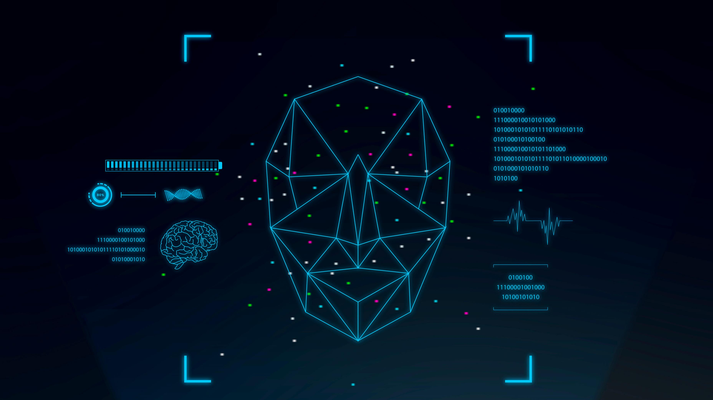
Face Recognition System

Slide 10

KEY NOTES
The Face Recognition System is a secure and efficient technology for identity verification, utilizing advanced facial recognition to prevent fraud and enable real-time authentication.
Key trends include 3D facial authentication for enhanced accuracy, contactless transactions, and integration with IoT and AR/VR for immersive experiences

Slide 11


CHALLENGES AND COMPETITORS
Challenges involve ethical concerns, issues with accuracy under diverse conditions, and high implementation costs
Competitors like Amazon Rekognition, Face++, and Kairos offer features such as spoof detection, deep learning integration, and advanced trait identification.

Slide 12

TARGET AUDIENCE
Corporations and Enterprises
Government Facilities
Airports and Transportation Hubs
Banks and Financial Institutions

Slide 13
PSYCHOGRAPHICS
Security-Oriented: Focused on safeguarding identities and assets.
Efficiency-Seeking: Interested in streamlining authentication processes.
Privacy-Conscious: Prefer systems that ensure data security and compliance
DEMOGRAPHICS
Age: 25–60 years
Income Level: Professionals in mid to high-income brackets

Slide 14
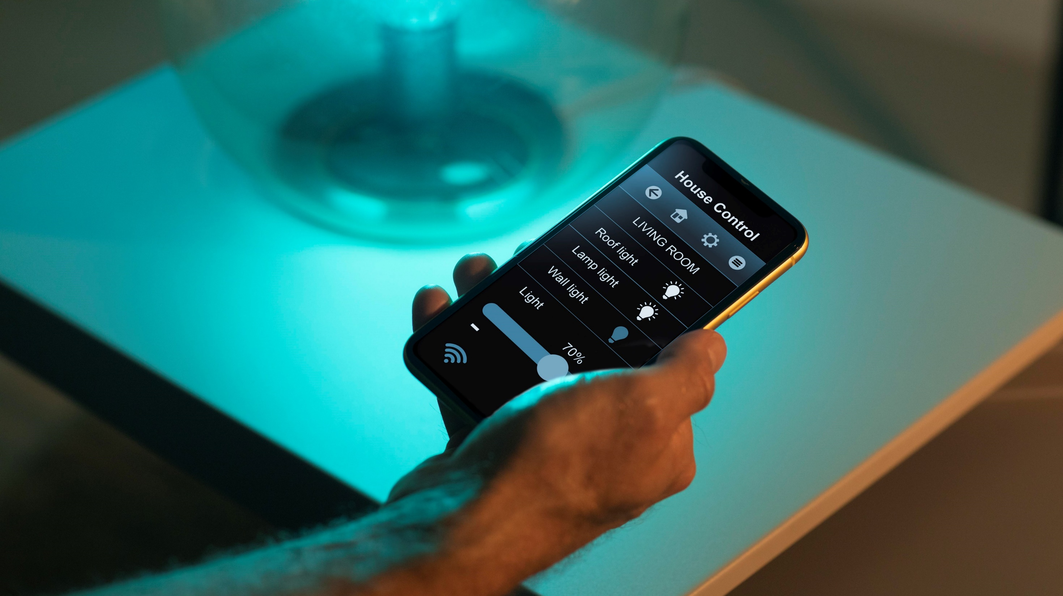
Home Automation

Slide 15
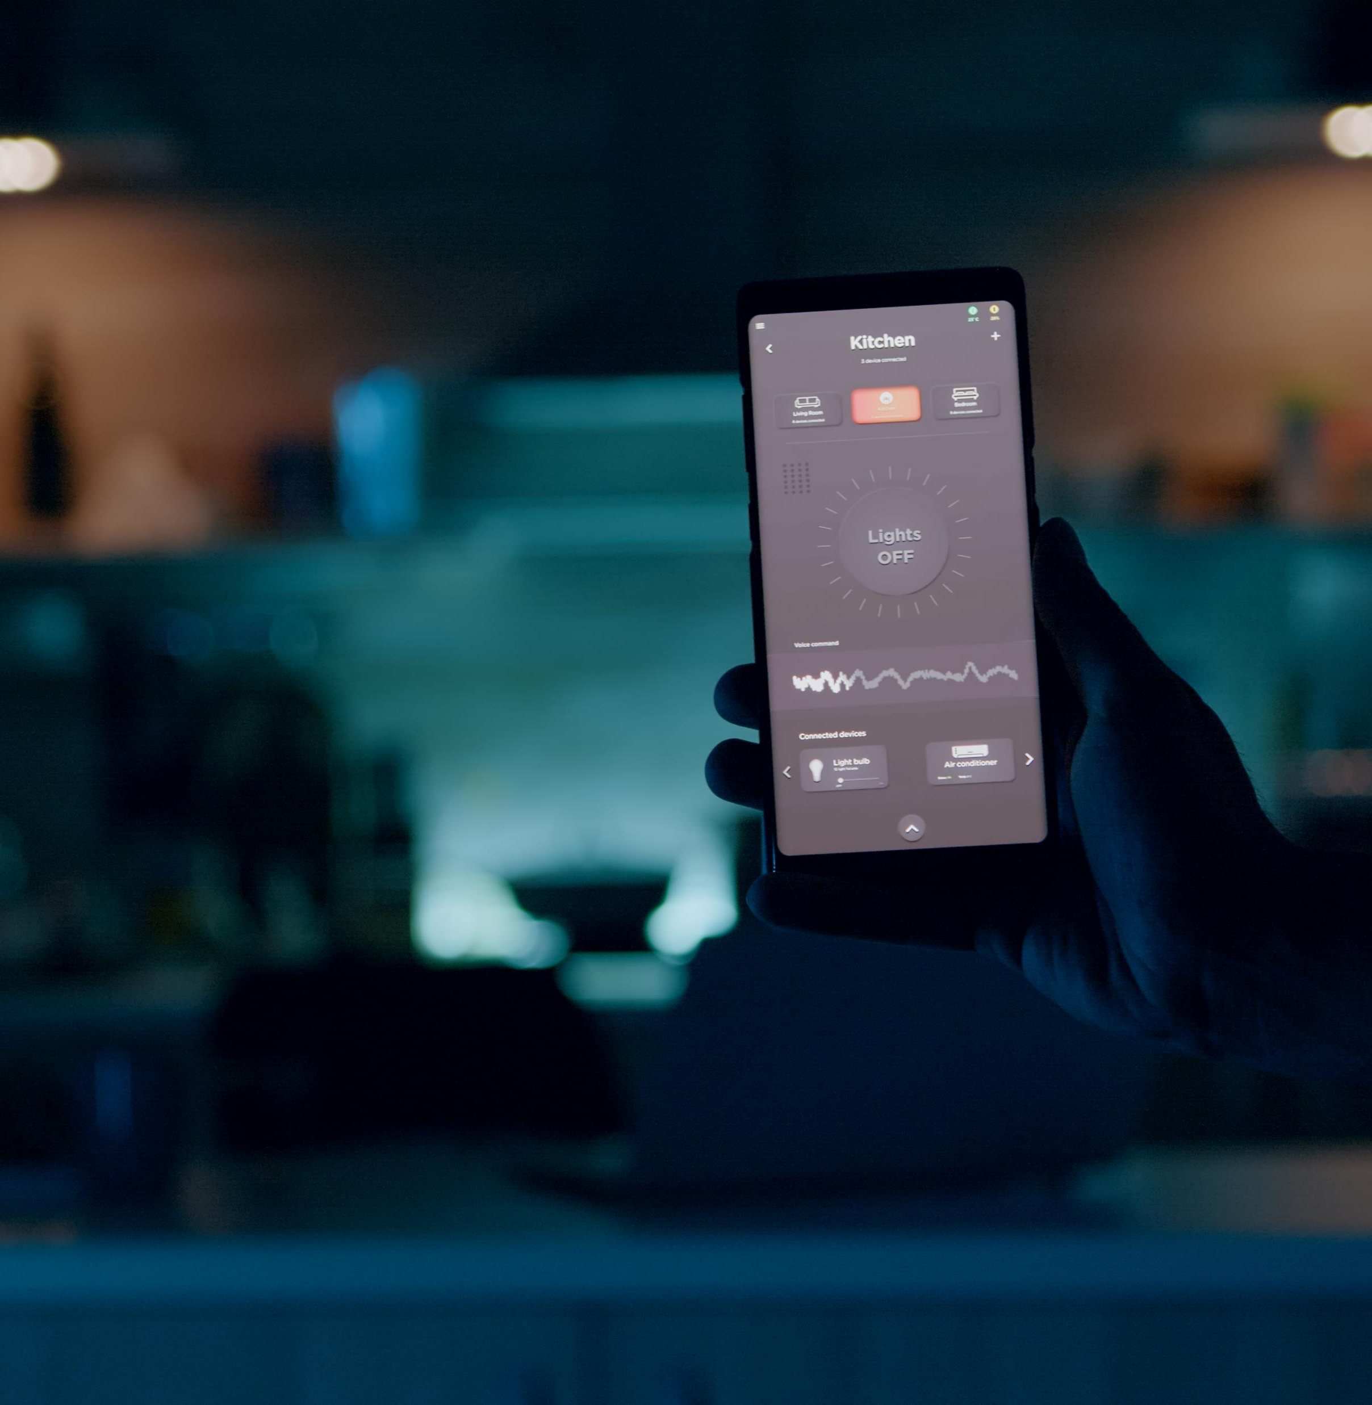
FINDINGS ABOUT THE PRODUCT
The Home Automation system offers intuitive control of smart home devices through hand gestures, enhancing convenience and personalization.
It leverages advanced voice and gesture control, IoT integration, and AI-driven learning to tailor user experiences
Challenges include interoperability issues across devices, cybersecurity risks, and high adoption costs.

Slide 16

COMPETITORS FOR THE PRODUCT
Competitors like TeslaTech India, SmarDen, and BuildTrack provide solutions ranging from smartphone control to energy-efficient wireless systems.
TRENDING ONE IN THE MARKET
Google Nest Hub with Motion Sense, enabling touch-free interactions such as snoozing alarms or skipping songs, demonstrating the appeal of gesture-based automation in modern households.

Slide 17
TARGET AUDIENCE FOR PRODUCT
High-Income Households
Luxury Property Owners
Tech Enthusiasts
Eco-Conscious Consumers

Slide 18
PSYCHOGRAPGHICS
Convenience Seekers: Interested in hands-free and intuitive solutions.
Eco-Conscious: Preference for energy-efficient and sustainable systems.
Lifestyle Innovators: Want futuristic, stylish, and easy-to-use technology.
DEMOGRAPHICS
Age: 25–55 years
Income Level: High-income, affluent homeowners
Location: Luxury properties in urban and suburban areas

Slide 19

Customized Humanoid Robot

Slide 20
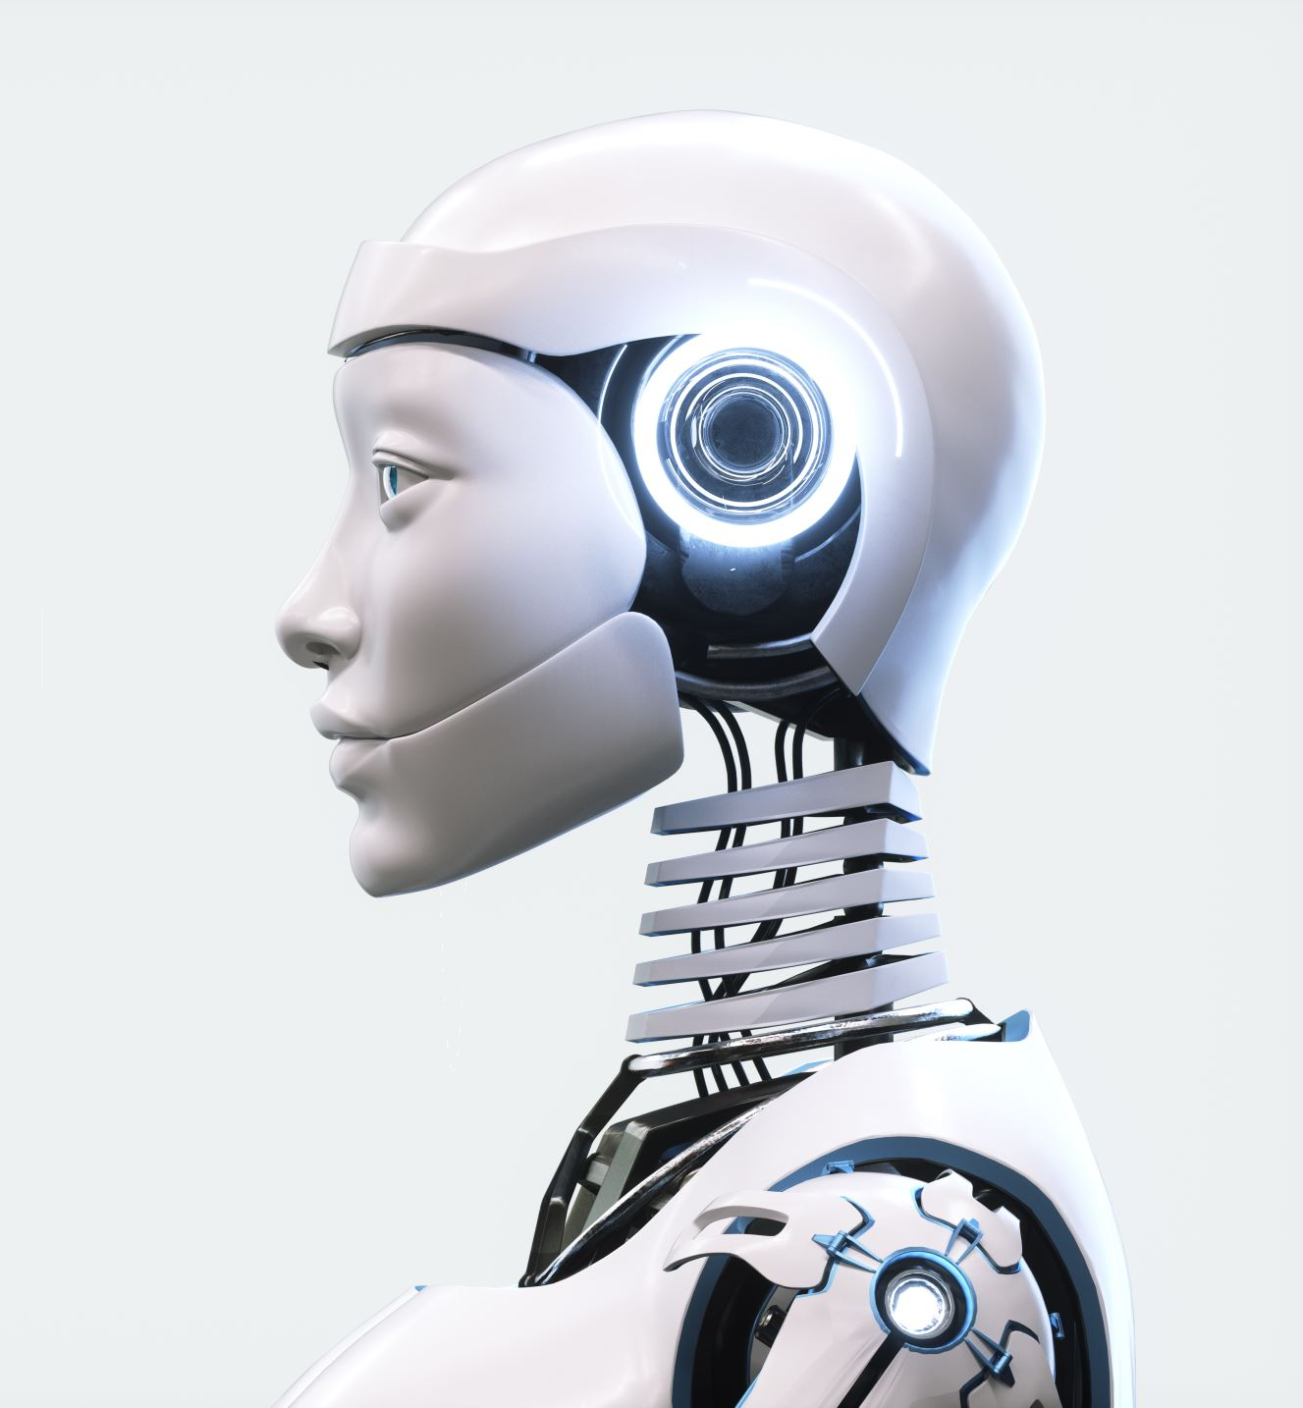
KEY FACTORS OF CUSTOMIZED HUMANOID ROBOT
The Customized Humanoid Robot is designed for education and retail, offering natural human-like interactions to enhance productivity and engagement.
Key trends include human-robot collaboration, advanced AI and machine learning for environmental adaptation, and the rise of Robotics-as-a-Service (RaaS) to reduce upfront costs.

Slide 21
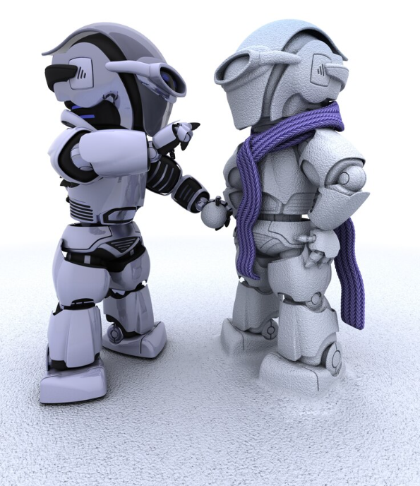
MAIN COMPETITORS
Competitors like PAL Robotics, UBTECH, and Boston Dynamics offer specialized solutions ranging from healthcare to industrial application
REAL TIME EXAMPLE
The NAO Robot by SoftBank Robotics is widely used in schools for teaching STEM skills and in retail for customer assistance, showcasing its versatility and potential impact.

Slide 22
TARGET AUDIENCE
Educational Institutions
Retail Outlets
Healthcare Providers
Research Facilities
Businesses with Innovation Budgets

Slide 23
PSYCHOGRAPHICS
Innovation-Driven: Attracted to cutting-edge technology for productivity and engagement.
Practical-Minded: Focused on how robots can solve specific problems like labor shortages.
Visionary Thinkers: Interested in long-term applications of robotics in their industry.
DEMOGRAPHICS
Age: 30–50 (decision-makers in organizations)
Income Level: Institutional buyers with innovation budgets

Slide 24
SWOT Analysis for AI Theft Camera
STRENGTHS
WEAKNESSES
Advanced Video Monitoring: AI-driven analytics ensure real-time detection of threats.
Smart Home Integration: Seamless compatibility with existing smart home ecosystems.
Regulatory Compliance Features: Built-in privacy and encryption to meet standards.
High Initial Costs: Expensive setup and maintenance deter small businesses.
Limited Awareness: Customers may not understand the product's full potential

Slide 25

OPPORTUNITIES
THREATS
Rising Smart Home Adoption: Growing demand for integrated security systems.
Market Expansion: High potential in high-crime urban areas and retail sectors.
Regulatory Challenges: Privacy concerns could limit adoption.
Competitive Landscape: Companies like Veesion and Panoptyc offer similar solutions.

Slide 26
AI Theft Camera: Sales and Success Metrics
Out of the four innovative AI-driven products, we’ve focused on the AI Theft Camera to analyze its sales performance and impact across key sectors:
Banks: Ensuring high-security monitoring for sensitive assets.
Retail Stores: Reducing theft incidents and safeguarding inventory.
Homes: Offering advanced security for tech-savvy homeowners

Slide 27
KEY PERFORMANCE INDICATOR(KPIs)
Sales Performance
Metric: Units sold by region and sector (e.g., banks, retail stores).
Example: In the first six months:
Banks: 500 units sold at $1,000/unit = $500,000 revenue.
Retail Stores: 800 units sold at $800/unit = $640,000 revenue.
Homes: 300 units sold at $700/unit = $210,000 revenue. Total Revenue: $1,350,000.

Slide 28
Adoption Rate
Metric: Percentage of existing customers upgrading to AI Theft Cameras.
Example: Out of 1,000 existing customers, 400 upgraded to the AI model. Adoption Rate: (400 / 1,000) × 100 = 40%.

Slide 29
Customer Satisfaction
Metric: Feedback scores from users regarding privacy and performance.
Example: A post-sale survey of 1,000 customers yields:
800 satisfied customers gave a score of 4/5 or above. Satisfaction Rate: (800 / 1,000) × 100 = 80%.

Slide 30
Return on Investment (ROI)
Metric: Revenue generated compared to development and operational costs.
Example:
Development Costs: $500,000.
Operational Costs (manufacturing, marketing): $300,000.
Revenue: $1,350,000. ROI Formula: ((Revenue - Costs) / Costs) × 100. ROI: (($1,350,000 - $800,000) / $800,000) × 100 = 68.75%.

Slide 31


BLUEPRINT FOR SUCCESS
Launch educational programs showcasing real-world success stories to build customer trust and understanding.
Introduce subscription-based or modular pricing to cater to both budget-conscious customers and premium users.
Develop AI models to reduce false alarms and improve real-time threat detection accuracy
Offer 24/7 support and post-sales assistance to ensure user satisfaction and build long-term loyalty.

Slide 32
Thank you!

